Slide 1
INSAID Project – Term 1&2
Analysis on Automobile data
By Dipu Joy

Slide 2
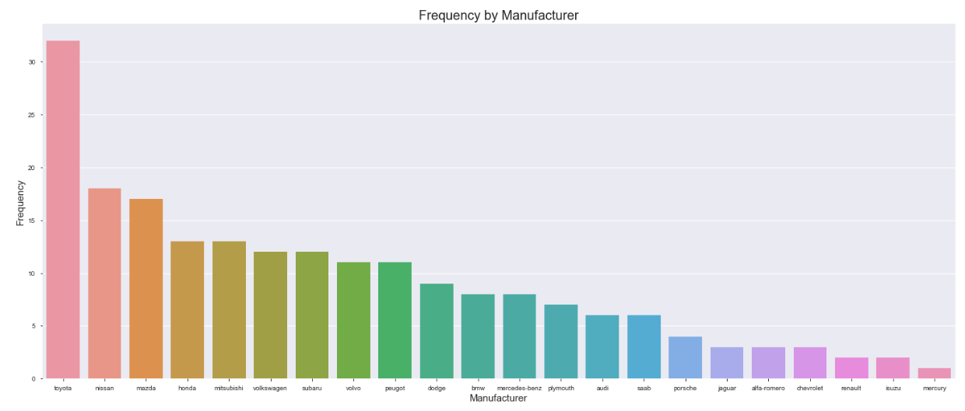
Distribution by ‘Make’ shows that Toyota has the maximum no of cars, followed by Nissan and Mazda
Most of the Toyota cars are hatchback followed by sedan

Slide 3
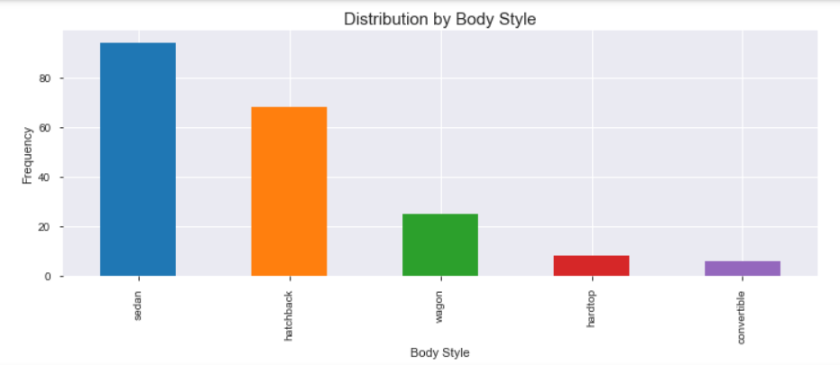
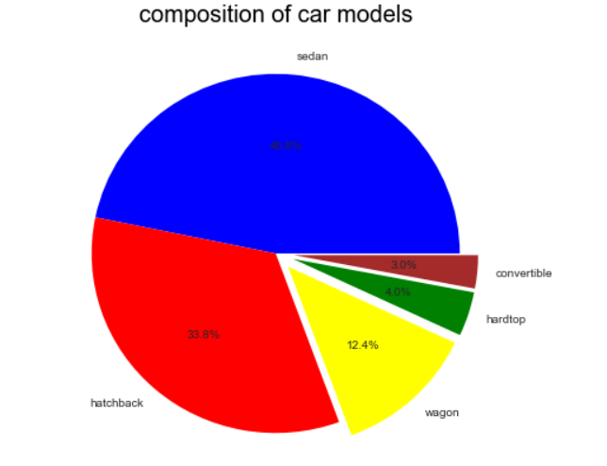
Distribution by ‘Body Style’ shows that Sedan has the maximum observations – 46.8%
Followed by hatchback – 33.8%
Convertibles form a very less percentage

Slide 4
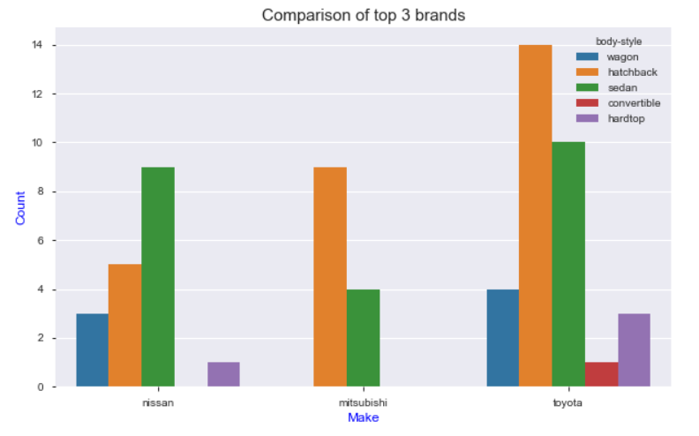
Distribution of top 3 brands by count shows most of Toyota cars are hatchbacks
Followed by Nissan which mostly has sedans
Convertibles and hardtops are premium models and figure very less

Slide 5
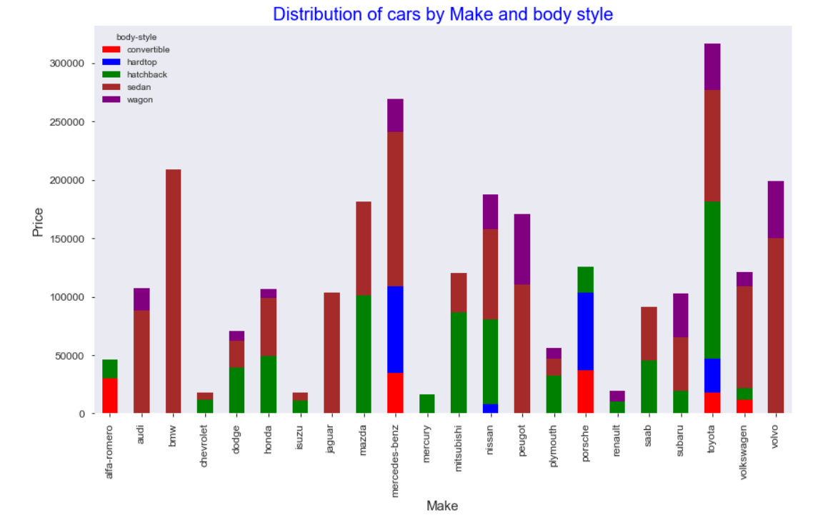
Distribution by ‘Make’ and ‘Body style’ we infer that “Toyota” has most no of cars by value
Most of the Toyota cars are hatchback followed by sedan
Compared to first slide we see that “Mercedes Benz” is second brand by value followed by BMW

Slide 6
Comparing Price and city mileage we the lower priced cars have better mileage
These are usually hatchbacks(red) and wagon(blue)
Some of the expensive sedans, hardtops and convertibles have very low mileage

Slide 7
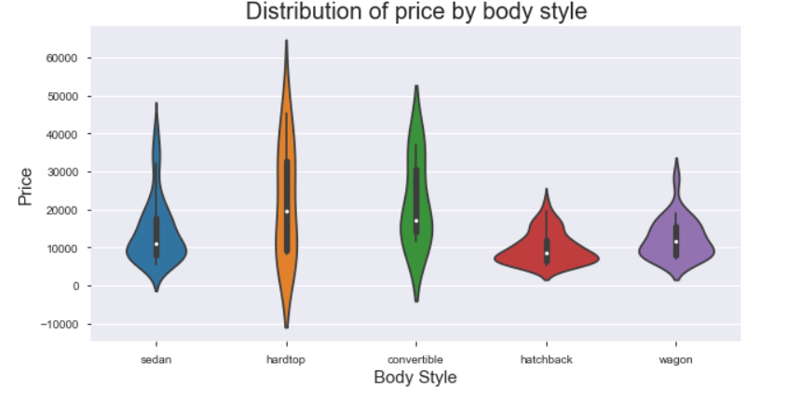
Comparing Price and body style, we see that hatchback and wagon does not have much variation in prices
But hardtop and convertibles are spread on huge range of price

Slide 8
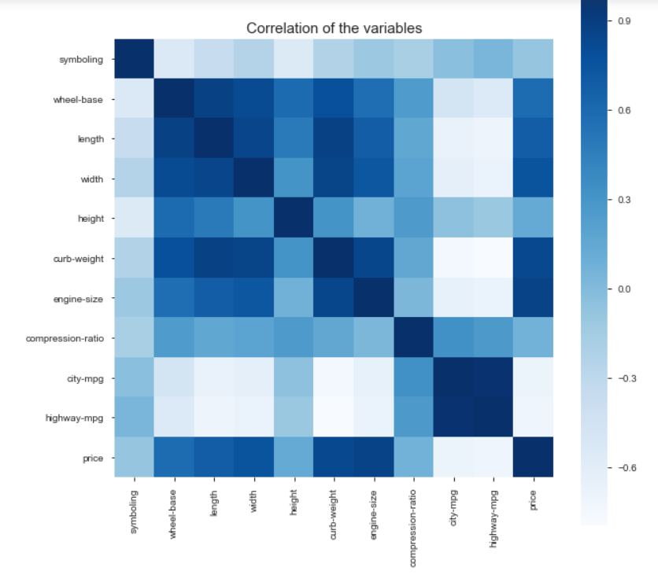
Looking at correlation among the variables, it is clear that wheel-base, length, width and curb-weight are highly correlated
Price is strongly correlated with length, width, curb-weight and engine-size

Slide 9
Conclusions
Based on the automobile dataset, we see that maximum cars are in hatchback and wagon category
Toyota is the brand with most number of cars
Mercedes Benz having fewer cars is second based on value(price)
Price increases based on length, width, curb-weight and engine-size
Mileage is better for low priced cars especially hatchbacks and wagons
Convertibles and hardtops are premium vehicles in higher price category

